Slide 1
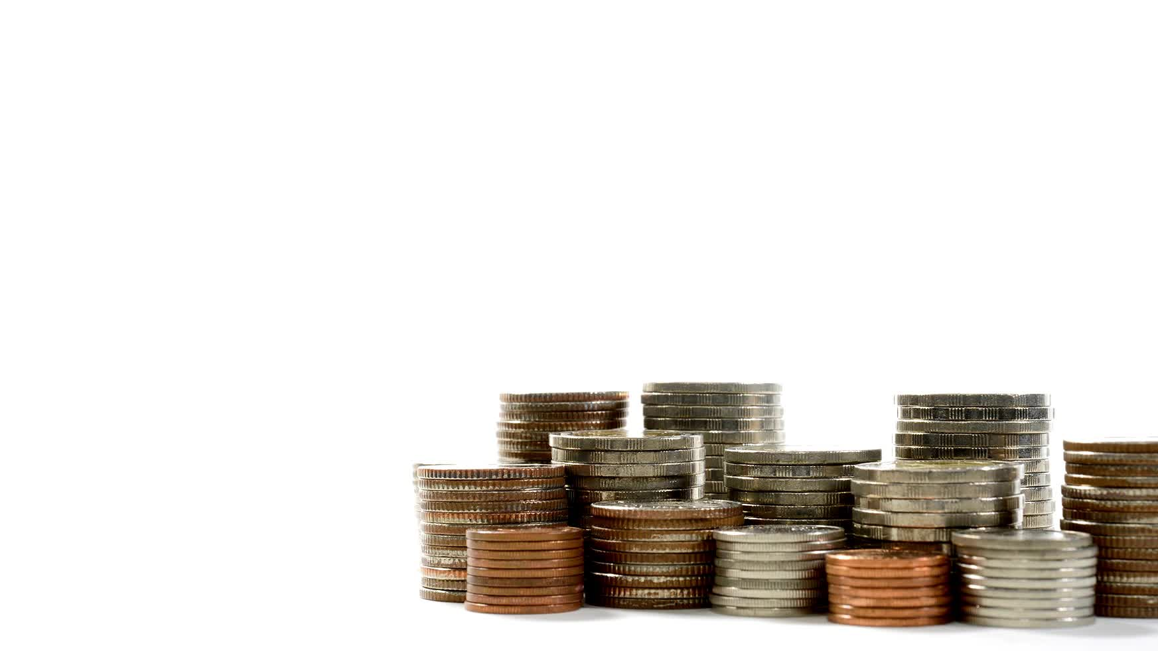
Let's talk Money
With Sheffield Voices and Money Saving Expert

Slide 2
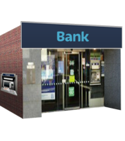
What is a bank account?
A bank account allows you to store money
You can take money out and put money in

Slide 3
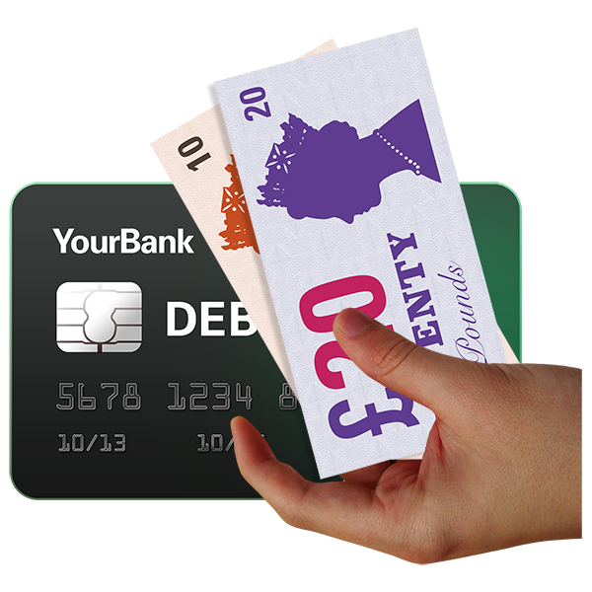
Why do you need a bank account?
People like to keep their money safe so you do not have cash around your home
You can have your benefits or your wages paid directly into your bank account
You can even pay your bills straight from your bank account

Slide 4
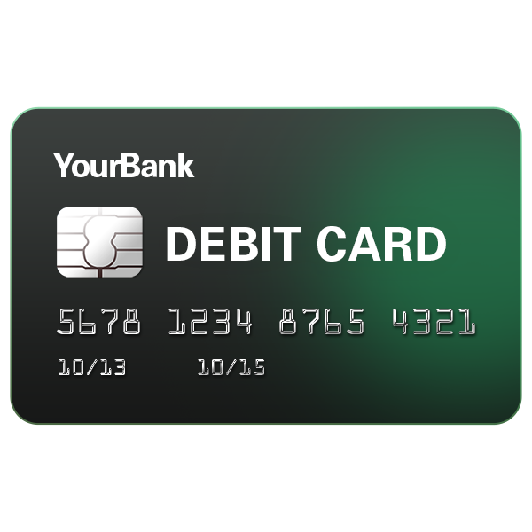
If you have a bank account, you can get a card that looks like this
Do you know what you might use of these for?

Slide 5
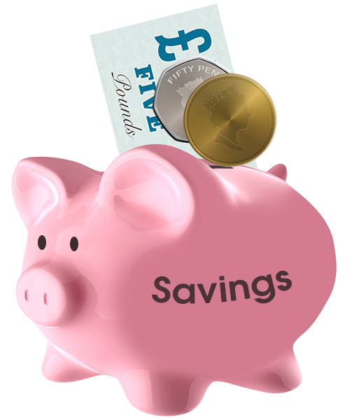
If you have an account, what type of account is it?

Slide 6
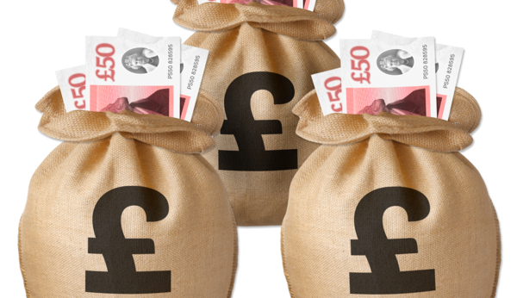
Do you have any questions about bank accounts?

Slide 8
Where does money come from?
Draw your own picture of a tree on the large piece of paper and try and think of all the ways in which people get money

Slide 9
Cost of Living and Budgeting
You might already know we are living in difficult times where the cost of things are going up.
Can you think of things that have gone up that are affecting you?

Slide 10
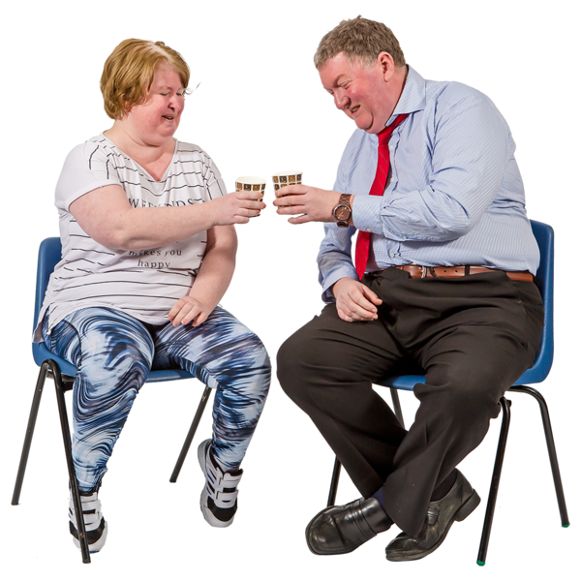
Ow Much’opoloy

