Slide 1
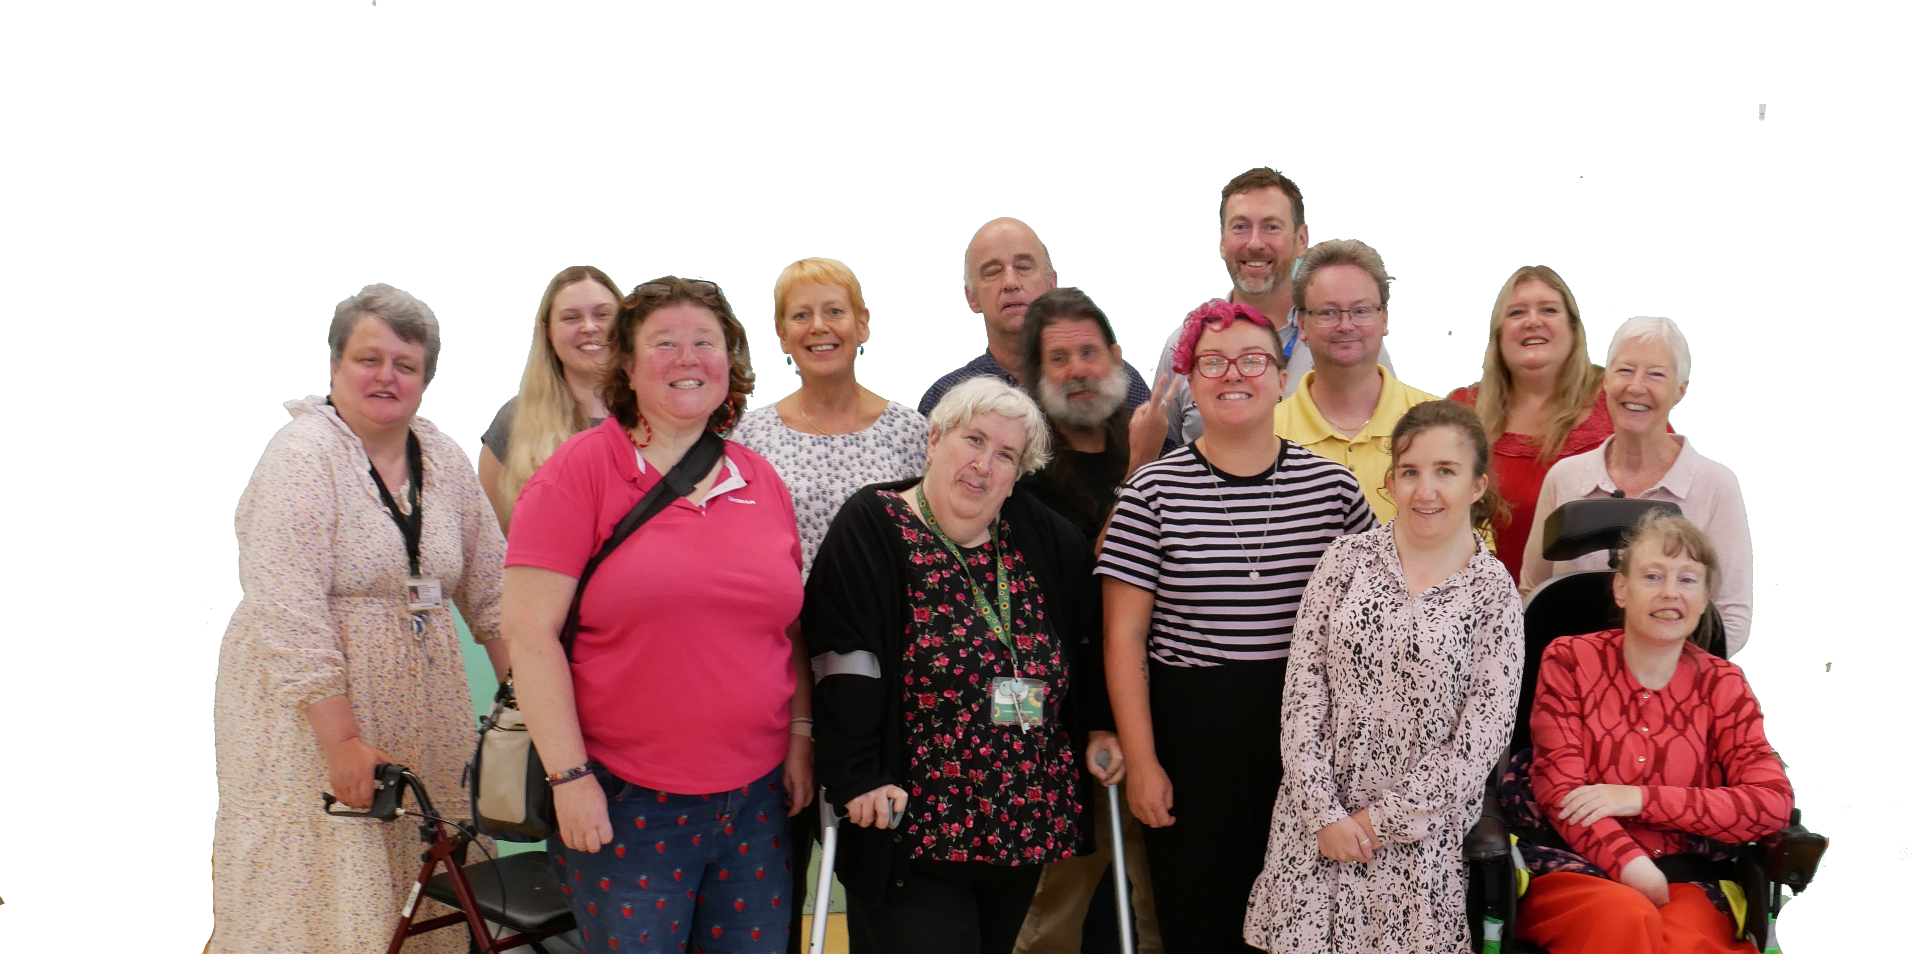
Welcome to We Speak You Listen

Slide 2
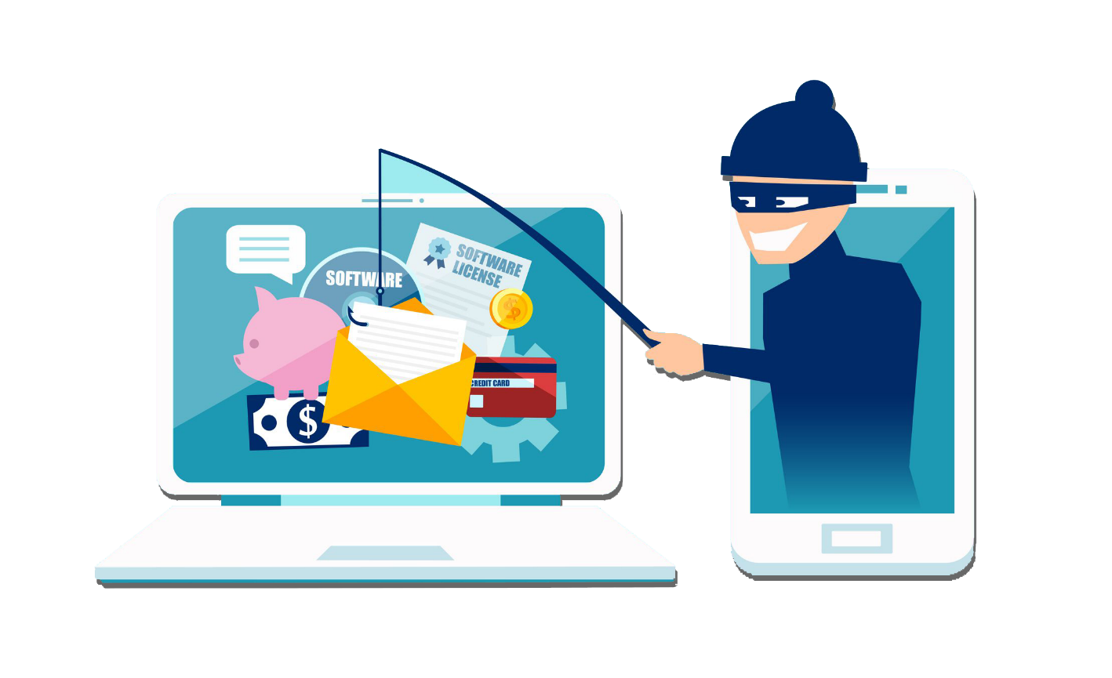
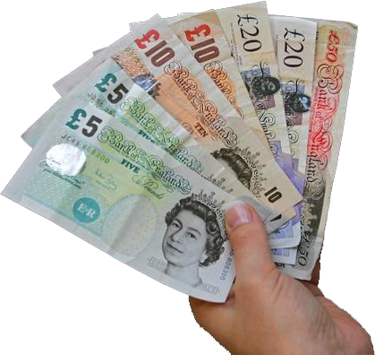
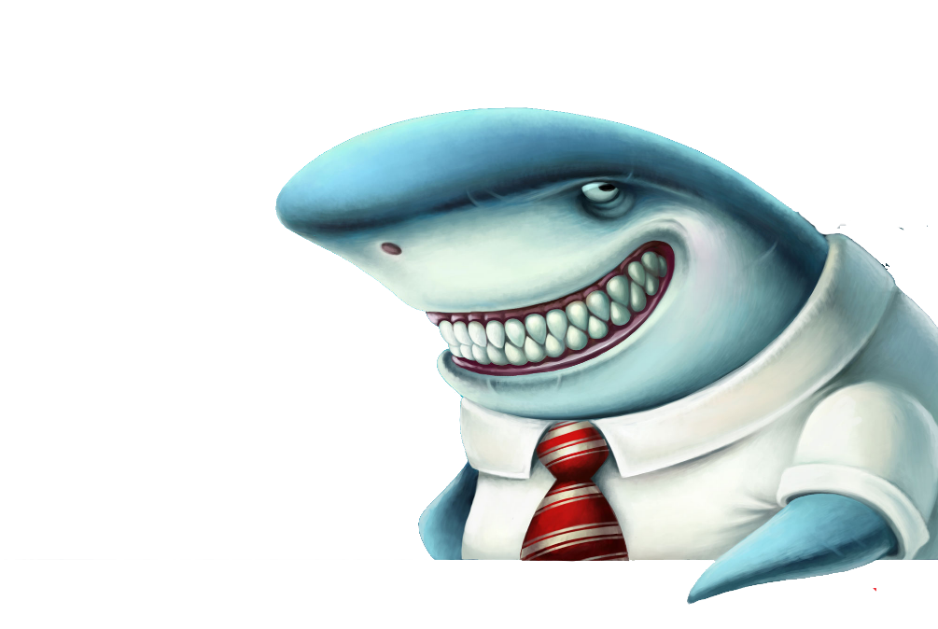
SCAMS AND SHARKS

Slide 3
What do you think a Scam is?

Slide 4
Scams
A scam is when people or a person plans to take money or information, by tricking someone

Slide 5
Scams
It may be a scam if it seems too good to be true.
For example, an iPhone that is being sold for £25.

Slide 6
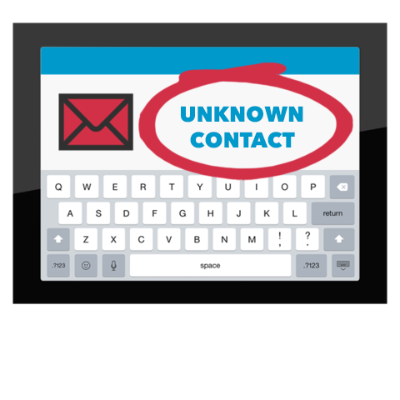
Scams
It may be a scam if someone you don’t know contacts you.

Slide 7
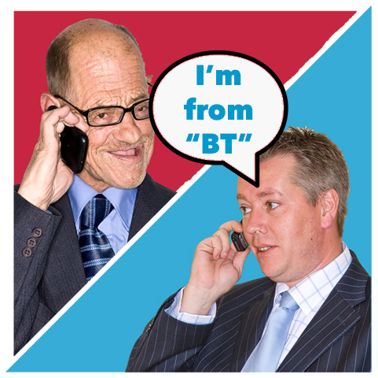
Scams
Someone may even call you and say they are from a well-known company like “Microsoft” or ”BT”.

Slide 8
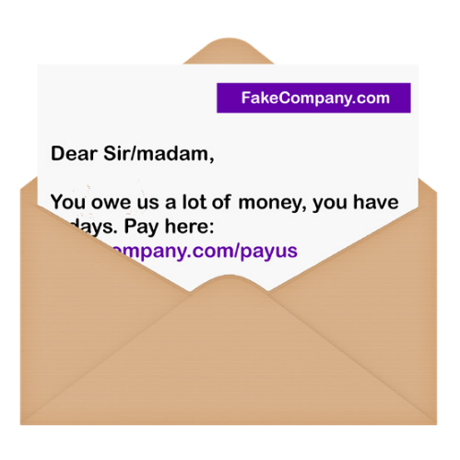
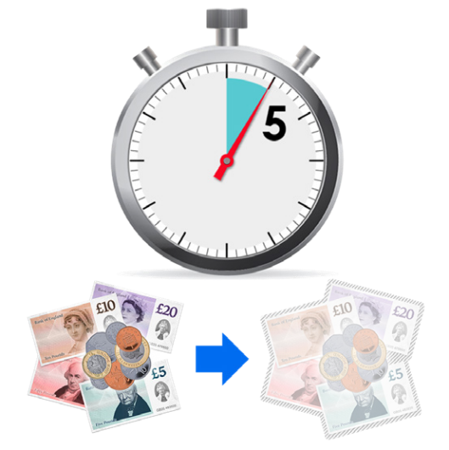
Scams
There are lots of different ways people can be ‘scammed’
Can you think of other examples?
Talk on table about this

Slide 9
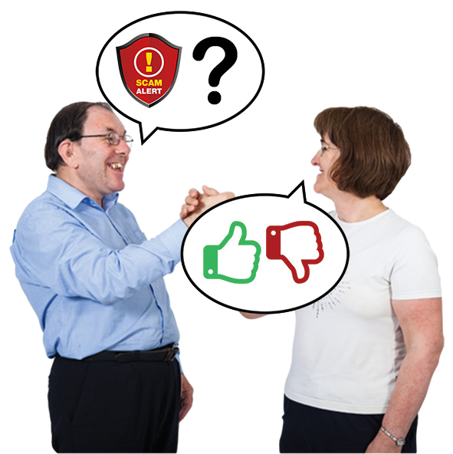
Scams
If you not sure if you are being scammed, talk to someone you trust.
Never feel pressured into giving money or personal information away.

Slide 10
Scams
You can ask Citizens Advice or Friends Against Scams.
What would you do if you thought you were being scammed?

Slide 11
TIME FOR A BREAK
10 minutes

Slide 12
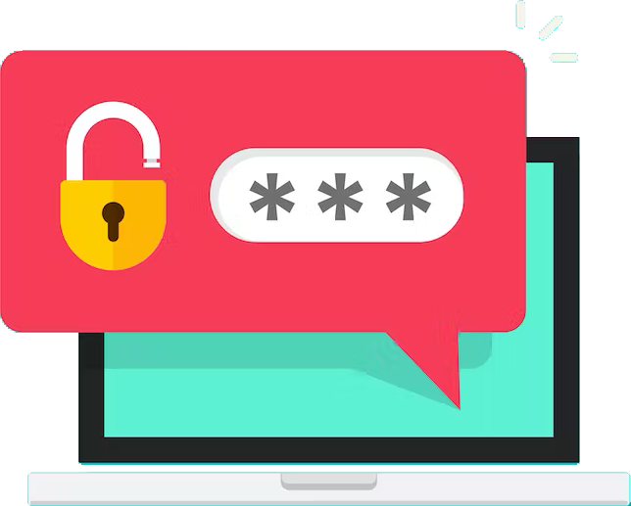
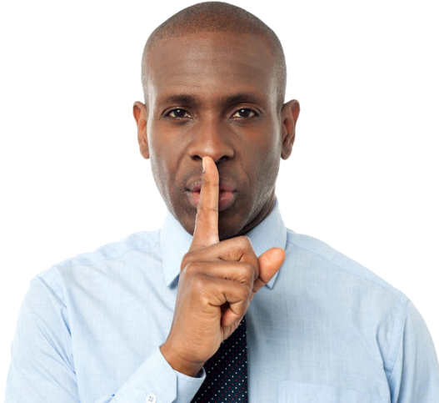
What is a Password?

Slide 13
Passwords
A password is like a lock.
We need passwords to prove who we are on websites, email accounts and computers and to keep your information safe.

Slide 14
Passwords
Write down two pretend passwords that you can think of
BUT
Do not use your own personal passwords!

Slide 15
Passwords
Write a password that no one would guess.
This is called a strong password.

Slide 16
Passwords
Write down another password but one that you think people might be able to guess easily.
This is called a weak password.

Slide 17
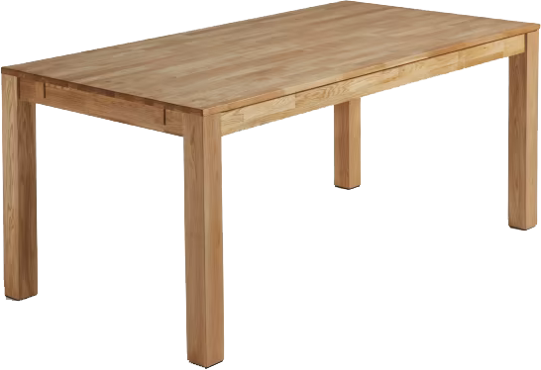
Passwords
Place your sticky notes either the good password sign or the bad password sign.
You can decide.

Slide 18
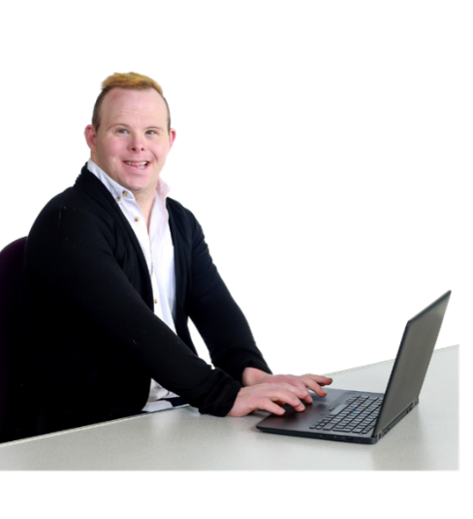
Passwords tips
Its important ALL your passwords are strong.
Try to use different passwords for different accounts.

Slide 19
Passwords
DON’T use :
Your username or your actual name.
Family members or pets names.
or anything simple, like ‘Password’

Slide 20
Passwords
To create a strong password, you could choose 3 words.
For example: cuptorchkettle

Slide 21
Passwords
Look at the passwords you have written and see if think they are strong or weak.
Move to the right piece of paper.

Slide 22
Passwords.

Slide 23
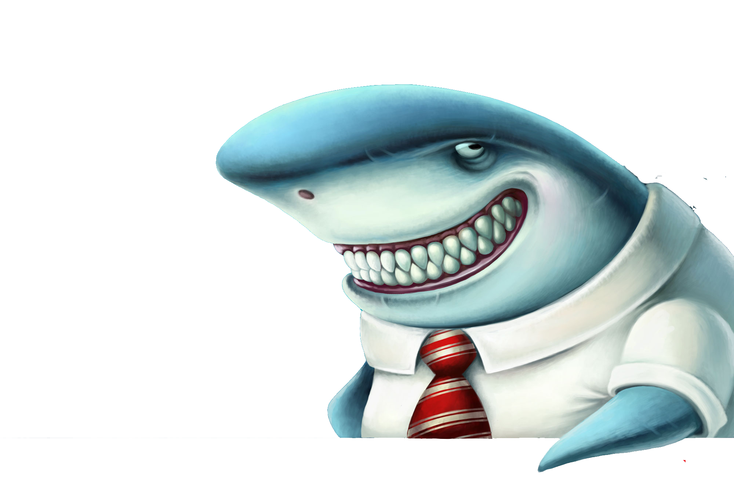
Lets talk about Loan Sharks

Slide 24
Loan Sharks
A Short Sketch from Robert, Katie and Marie.

Slide 26
Thank you for coming
We Speak you Listen Event

