Slide 1
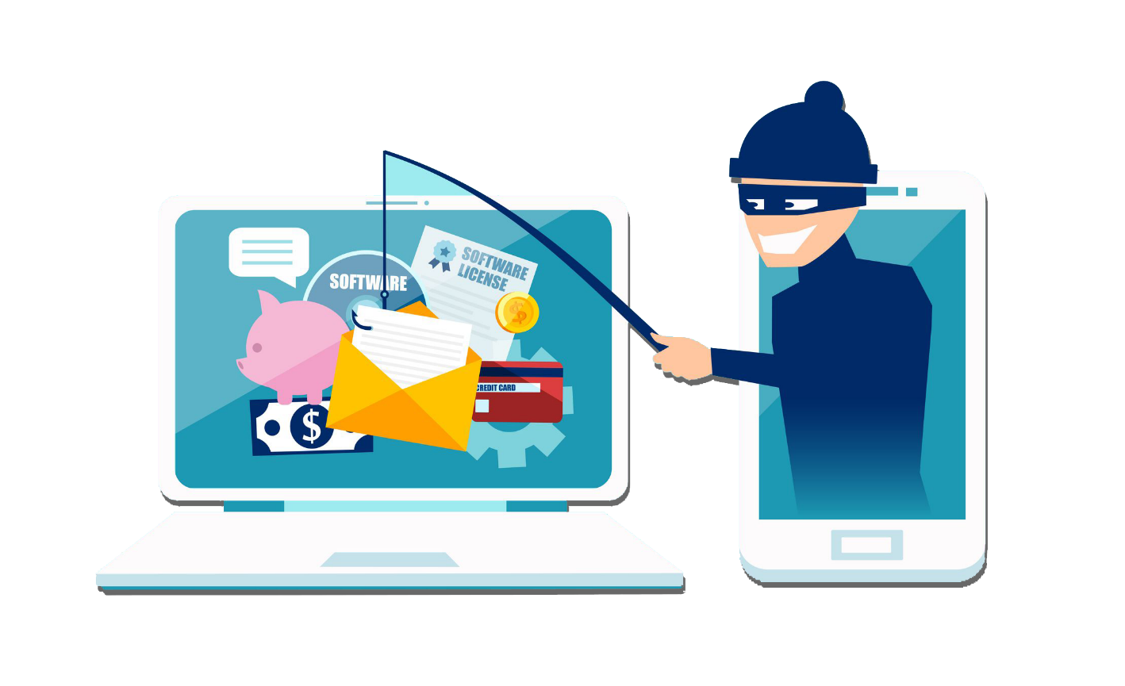
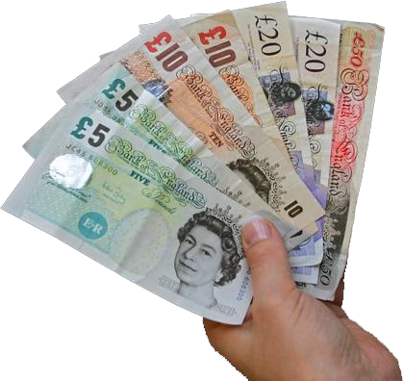
SCAMS

Slide 2
What is a Scam?

Slide 3
Scams
A scam is when people or a person plans to take money or information, by tricking someone

Slide 4
Scams
It may be a scam if it seems too good to be true.
For example, an iPhone that is being sold for £25.

Slide 5
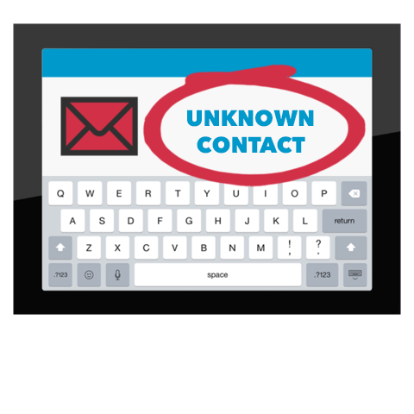
Scams
It may be a scam if someone you don’t know contacts you.

Slide 6
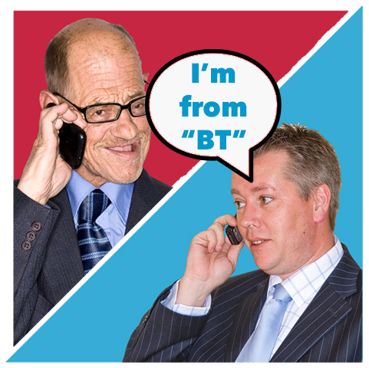
Scams
Someone may even call you and say they are from a well-known company like “Microsoft” or ”BT”.

Slide 7
Scams
You have call from unknown caller!

Slide 8
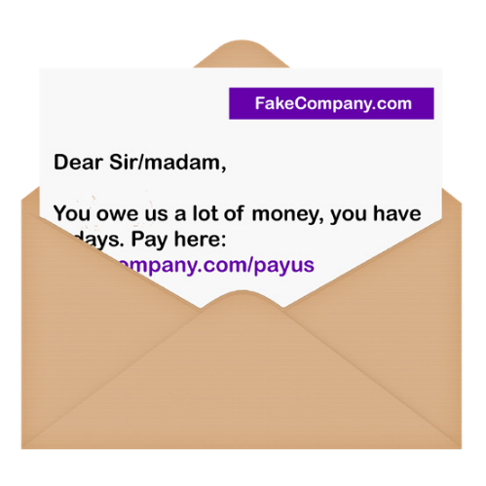
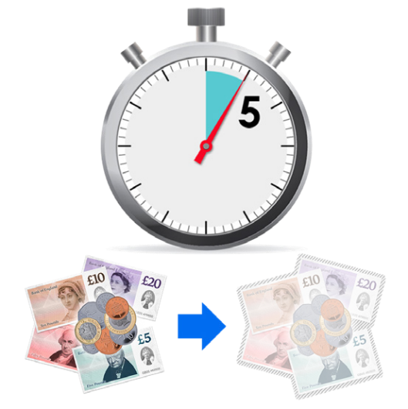
Scams
There are lots of different ways people can be ‘scammed’
Can you think of other examples?
Talk with your table about this

Slide 9
Scams
What would you do if you thought you were being scammed?

Slide 10
Scams
If you not sure if you are being scammed, talk to someone you trust.
Never feel pressured into giving money or personal information away.

Slide 11
Passwords.

Slide 13
Goodbye

